Slide 1
Foundations of AI:
Philosophy of Mathematics
Requires mathematical formalization in three fundamental areas: (1) Formal Logic (2) Computation & (3) Probability
The idea of formal logic is the contribution of great Greek philosophers, that we know.

Slide 2
Its mathematical development really began with the work of George Boole (d. 1864) in the form of propositional logic.
Gottlob Frege (d. 1925) extended Boole’s logic to include objects and relations, creating the first-order logic that is used today as the most basic knowledge representation system.
Alfred Tarski (d. 1983) introduced a theory of reference that shows how to relate the objects in a logic to objects in the real world.

Slide 3
David Hilbert (d. 1943)
Where there is an algorithm for deciding the truth of any logical proposition involving the natural numbers which is called as the decision problem.
Where there were fundamental limits of the power of effective proof procedures.

Slide 4
Kurt Godel (d. 1978)
Godel Showed that there exists an effective procedure to prove any true statement in the first-order logic of Frege and Russell, but that first-order logic could no capture the principle of mathematical induction needed to characterize the natural numbers.

Slide 5
The Incompleteness theorem
Godel’s incompleteness theorem showed that in any language expressive enough to describe the properties of the natural numbers, there are true statements that are undecidable in the sense that their truth cannot be established by any algorithm.

Slide 6
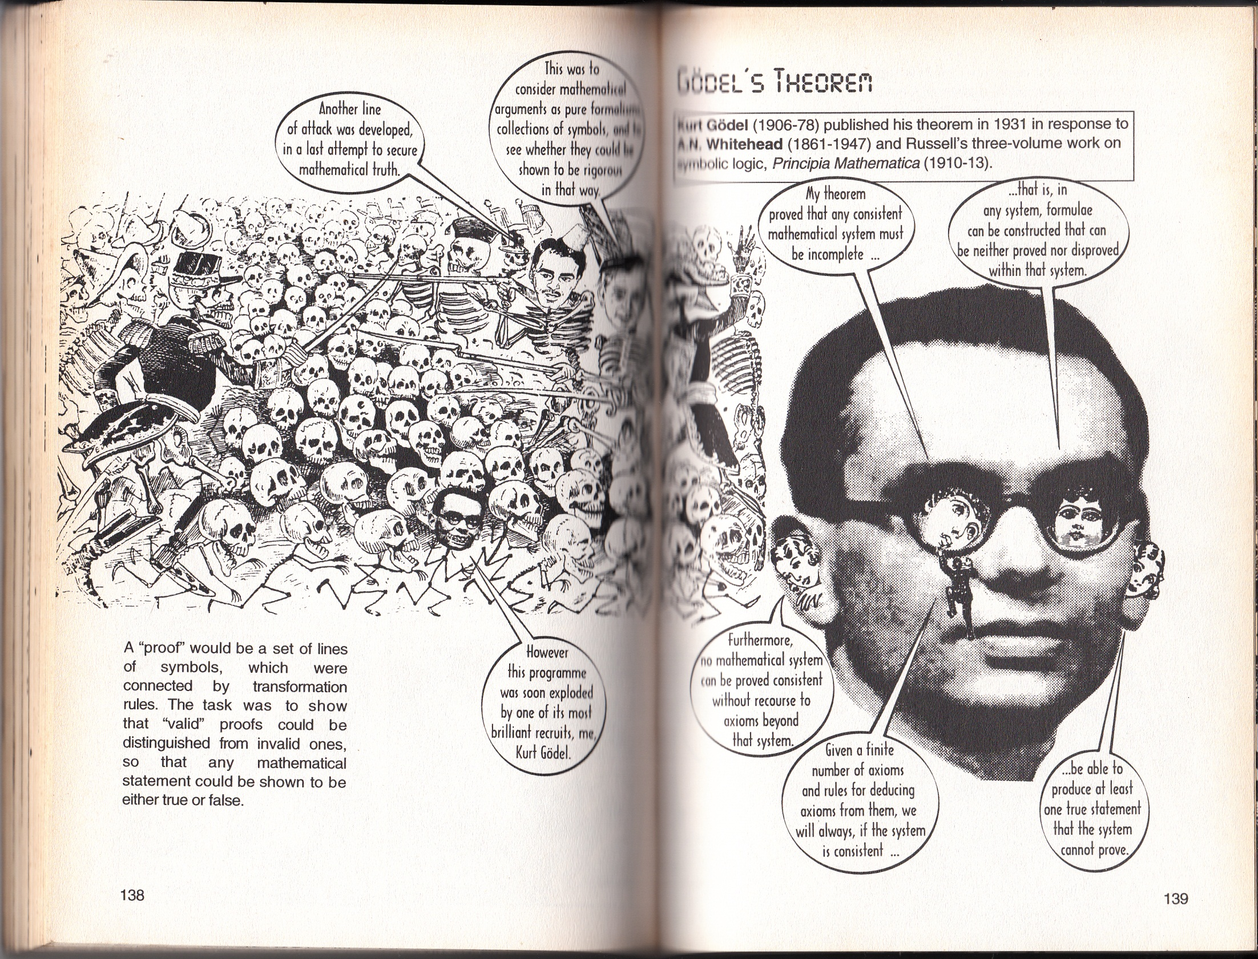

Slide 7
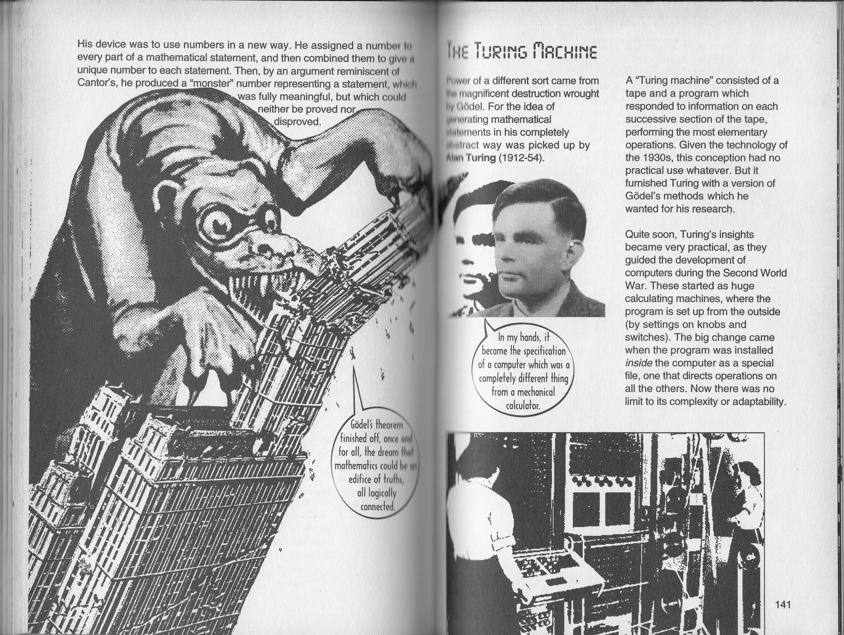

Slide 8
Alan Turing (d. 1954)
If there are some functions on the integers that cannot be represented by an algorithm then exactly which functions are capable of being computed? 1936 Turing proposed that the ‘turing machine’ is capable of computing any computable function, is generally accepted as providing a sufficient definition.

Slide 9
Turing also showed that there are some functions that no ‘turing machine’ can compute.
For example, no machine can tell in general whether a given program will return an answer on a given input or run forever.

Slide 10
Intractability
A problem is called intractable if the time required to solve instances of the problem grows exponentially with the size of the instances. Exponential growth means that even moderately large instances cannot be solved in any reasonable time. Therefore, one should strive to divide the overall problem of generating intelligent behavior into tractable subproblems rather than intractable ones.

Slide 11
Popular optimism about Computer system
Electronic super brain ! Faster than Einstein !
But, ‘the world seems to be an extremely large problem instance!!!!!!!!!!!!!
Scientificism and
the constant gap theory (CGT)

Slide 12
Probability
An Italian, Gerolamo Cardano (d. 1576) first framed the idea of probability, describing it in terms of the possible outcomes of gambling events. Probability is necessary part of all the quantitative sciences, helping to deal with uncertain measurements and incomplete theories.
Thomas Bayes (d. 1761) proposed a rule for updating probabilities in the light of new evidence. Bayes’ rule and the resulting field called Bayesian analysis form the basis of most modern approaches to uncertain reasoning in AI systems.

